Slide 1
Lecture 5 - Employee Recruitment, Selection, Training and Development
Managing Business

Slide 2
Learning Outcomes
At the end of the lecture, you should be able to:
  Discuss the major sources of potential job candidates.
  Describe the different selection devices and which work best for different jobs.
  Describe the different types of training and how that training can be provided.

Slide 3
The Importance of Human Resource Management (HRM)
As a necessary part of the organizing function of management
  Selecting, training, and evaluating the work force
As an important strategic tool
  HRM helps establish an organization’s sustainable competitive advantage.
Adds value to the firm
  High performance work practices lead to both high individual and high organizational performance.

Slide 4
The HRM Process
Functions of the HRM Process
  Ensuring that competent employees are identified and selected.
  Providing employees with up-to-date knowledge and skills to do their jobs.
  Ensuring that the organization retains competent and high-performing employees who are capable of high performance.

Slide 5
Current Assessment
Human Resource Inventory
  A review of the current make-up of the organization’s current resource status
  Job Analysis
    An assessment that defines a job and the behaviors necessary to perform the job
      Knowledge, skills, and abilities (KSAs)
    Requires conducting interviews, engaging in direct observation, and collecting the self-reports of employees and their managers.

Slide 6
Current Assessment (cont’d)
Job Description
  A written statement of what the job holder does, how it is done, and why it is done.
Job Specification
  A written statement of the minimum qualifications that a person must possess to perform a given job successfully.

Slide 7
Recruitment and Decruitment
Recruitment
  The process of locating, identifying, and attracting capable applicants to an organization
Decruitment
  The process of reducing a surplus of employees in the workforce of an organization
E-recruiting
  Recruitment of employees through the Internet
    Organizational web sites
    Online recruiters

Slide 8
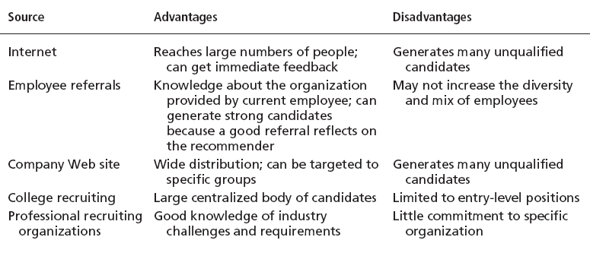
Major Sources of Potential Job Candidates

Slide 9
Selection
Selection Process
  The process of screening job applicants to ensure that the most appropriate candidates are hired.
What is Selection?
  An exercise in predicting which applicants, if hired, will be (or will not be) successful in performing well on the criteria the organization uses to evaluate performance.
  Selection errors:
    Reject errors for potentially successful applicants
    Accept errors for ultimately poor performers

Slide 10
Validity and Reliability
Validity (of Prediction)
  A proven relationship between the selection device used and some relevant criterion for successful performance in an organization.
    High tests scores equate to high job performance; low scores to poor performance.
Reliability (of Prediction)
  The degree of consistency with which a selection device measures the same thing.
    Individual test scores obtained with a selection device are consistent over multiple testing instances.

Slide 11

Selection Devices
Application Forms
Written Tests
Performance Simulations
Interviews
Background Investigations
Physical examinations

Slide 12
Written Tests
Types of Tests
  Intelligence: how smart are you?
  Aptitude: can you learn to do it?
  Attitude: how do you feel about it?
  Ability: can you do it now?
  Interest: do you want to do it?
Legal Challenges to Tests
  Lack of job-relatedness of test items or interview questions to job requirements
  Discrimination in equal employment opportunity against members of protected classes

Slide 13
Performance Simulation Tests
Testing an applicant’s ability to perform actual job behaviors, use required skills, and demonstrate specific knowledge of the job.
  Work sampling
    Requiring applicants to actually perform a task or set of tasks that are central to successful job performance.
  Assessment centers
    Dedicated facilities in which job candidates undergo a series of performance simulation tests to evaluate their managerial potential.

Slide 14
Other Selection Approaches
Interviews
  Although used almost universally, managers need to approach interviews carefully.
Background Investigations
  Verification of application data
  Reference checks:
    Lack validity because self-selection of references ensures only positive outcomes.
Physical Examinations
  Useful for physical requirements and for insurance purposes related to pre-existing conditions.

Slide 15
Suggestions for Interviewing
Structure a fixed set of questions for all applicants.
Have detailed information about the job for which applicants are interviewing.
Minimize any prior knowledge of applicants’ background, experience, interests, test scores, or other characteristics.
Ask behavioral questions that require applicants to give detailed accounts of actual job behaviors.
Use a standardized evaluation form.
Take notes during the interview.
Avoid short interviews that encourage premature decision making.
Source: Based on D.A. DeCenzo and S.P. Robbins, Human Resource Management, 7th ed. (New York Wiley: 2002, p. 200)

Slide 16
Other Selection Approaches (cont’d)
Realistic Job Preview (RJP)
  The process of relating to an applicant both the positive and the negative aspects of the job.
    Encourages mismatched applicants to withdraw.
    Aligns successful applicants’ expectations with actual job conditions; reducing turnover.

Slide 17
Orientation
Transitioning a new employee into the organization.
  Work-unit orientation
    Familiarizes new employee with work-unit goals
    Clarifies how his or her job contributes to unit goals
    Introduces he or she to his or her coworkers
  Organization orientation
    Informs new employee about the organization’s objectives, history, philosophy, procedures, and rules.
    Includes a tour of the entire facility

Slide 18
Types of Training
Type | Includes
General | Communication skills, computer systems application and programming, customer service, executive development, management skills and development, personal growth, sales, supervisory skills, and technological skills and knowledge
Specific | Basic life/work skills, creativity, customer education, diversity/cultural awareness, remedial writing, managing change, leadership, product knowledge, public speaking/presentation skills, safety, ethics, sexual harassment, team building, wellness, and others
Source: Based on “2005 Industry Report—Types of Training,” Training, December 2005, p. 22.

Slide 19
Employee Training Methods
Traditional
Training Methods
  On-the-job
  Job rotation
  Mentoring and coaching
  Experiential exercises
  Workbooks/manuals
  Classroom lectures
Technology-Based Training Methods
  CD-ROM/DVD/videotapes/ audiotapes
  Videoconferencing/ teleconferencing/
  satellite TV
  E-learning

Slide 20
Summary of Main Teaching Points
  Contrast job analysis, job description, and job specification.
  Explain what a realistic job preview is and why it is important.
  Describe the difference between recruitment and decruitment.

Slide 21
Question and Answer Session
Q & A

Slide 22
Next Session
Topic and Structure of next session
NEXT LESSON:
Management Theory and Practice

